Slide 1
Networking Fundamentals
Foundations of Ethernet and IP

Slide 2
IPv6 Concepts
#
Working with a 128-bit address

Slide 3
IPv6 Address Overview
128-bit address field
8 hextets, separated by colons
Subnet mask works exactly like IPv4, just longer
Address compression rules:
Remove all preceding 0s in a hextet
*Replace contiguous hextets of 0s with double colon ::
*Once per address
2001:0DB8:0000:0000:0000:0123:4567:89AB
|16 bits|
|---------------128 bits---------------|
2001:0DB8:0000:0000:0000:0123:4567:89AB
2001:DB8::123:4567:89AB

Slide 4
IPv6 Address Types
Global Unicast
2000::/3 – analogous to IPv4 public address space
Unique Local
fc00::/7 – analogous to RFC1918 IPV4 private address space
Link Local
fe80::/64 – not routable
Anycast
Same as global unicast but belonging to multiple nodes
Multicast
ff00::/8
Modified EUI 64
Process used to self assign a globally unique IPv6 address
Most common prefix length is /64
/64 is even recommended on point-to-point links due to EUI-64 compatibility

Slide 5
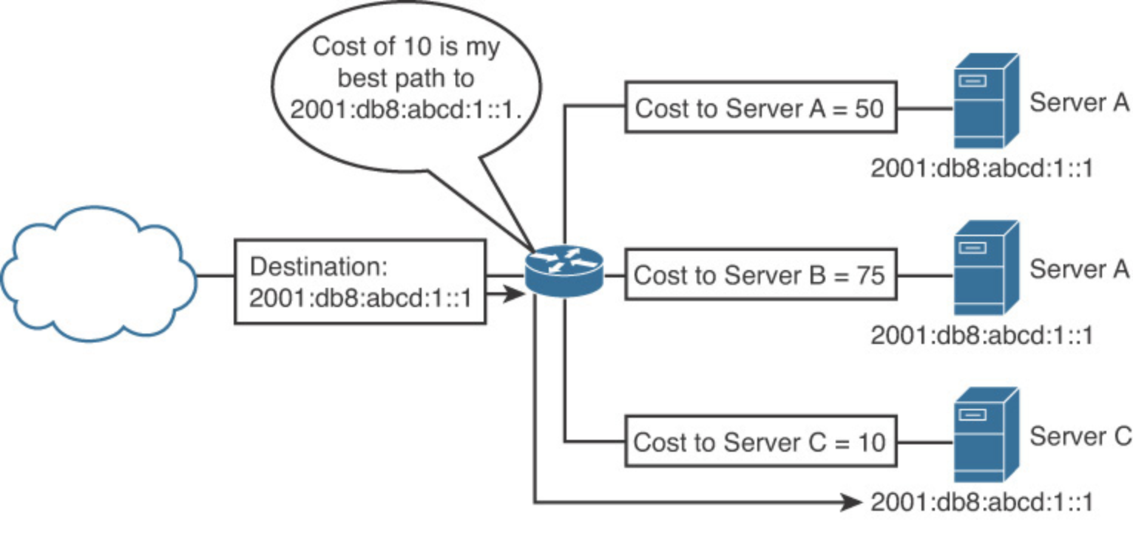
Anycast vs. Multicast
Multicast = 1 to many
Anycast = 1 to closest
Anycast uses same addresses as Global Unicast
Well-known multicast addresses:
ff02::1 - All IPv6 devices (broadcast)
ff02::2 - All IPv6 routers
ff02::5 - All OSPFv3 routers
ff02::a - All EIGRP(IPv6) routers

